Slide 1

Crosswords Game
Vishwaniketan's Institute of Management Entrepreneurship and Engineering Technology[iMEET], Khalapur
TEAM NUMBER- 04
Group member
1. KUNTE HARSH DEEPAK
2. MOKAL KARISHMA GAJANAN
3. JAPE SUPRIYA BABAN
4.MALKAR MANASI DINESH
5.BHADANE GAURAV BHAYYASAHEB
Under the guidance of
-Prof. N. ARJUNWADKAR
-Trainer – Mr. Ramkumar

Slide 2

Agenda
Introduction
Project Overview
Technology used
Prototype
Conclusion
References

Slide 3
Introduction
Single player crossword game.
Levels( Easy, Medium, Hard).
Improves vocabulary, increases knowledge.

Slide 4
Technologies Used
Java Development Kit 8 Update 181.
Eclipse Java PHOTON.
Corejava and MySQL 5.5(Back end).
MVC Architecture.
Java Swing(Front end).

Slide 5





Project Overview
EXISTING USER LOGIN
NEW USER REGISTRATION
LOGIN/REGISTRATION
CLICK THE START BUTTON
OR CHECK THE LEADERBOARD
STARTING THE GAME
EASY
MEDIUM
HARD
SELECTING THE LEVEL
SELECT THE LEVEL
GET READY TO SOLVE
PLAY ON!!
Fig. Flow of the game

Slide 6
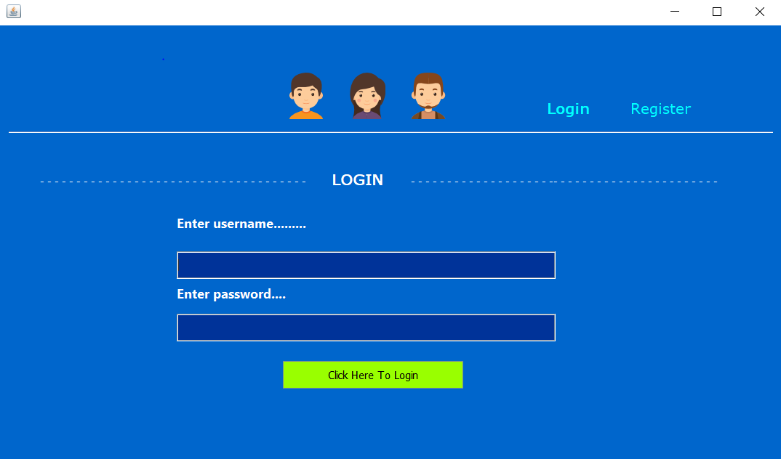
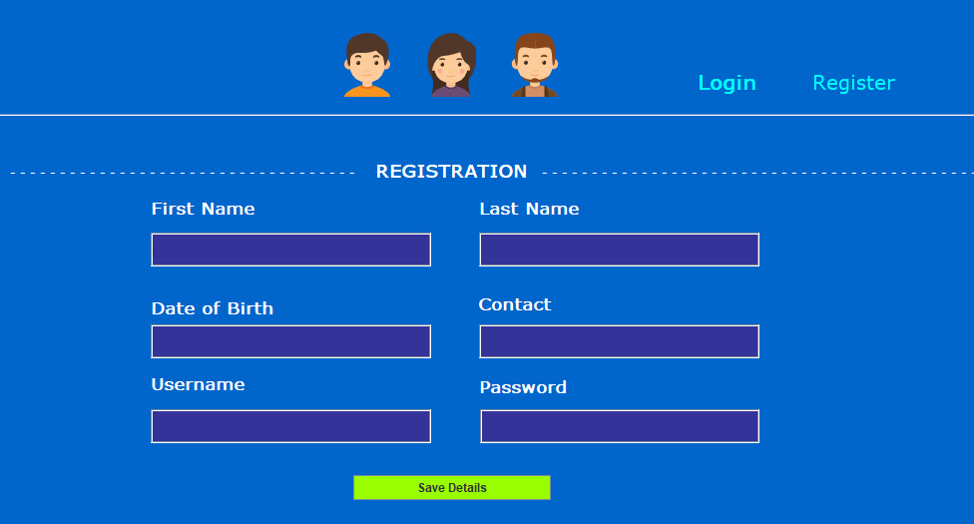
Prototype
Fig 1. Login Page
Fig 2. Registration Page

Slide 7
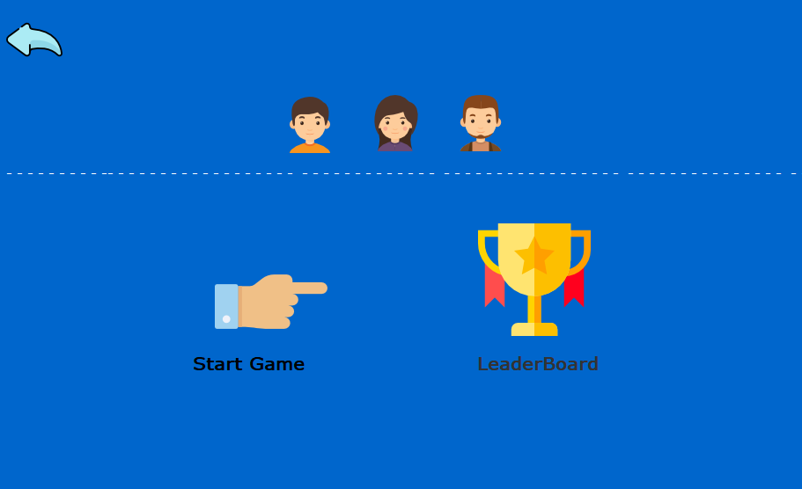
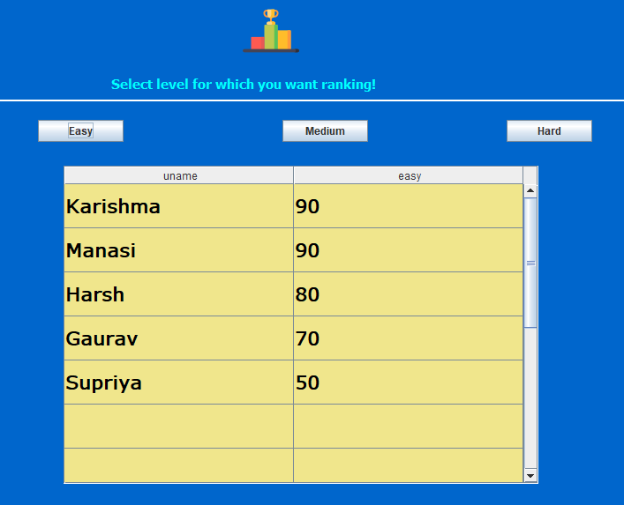
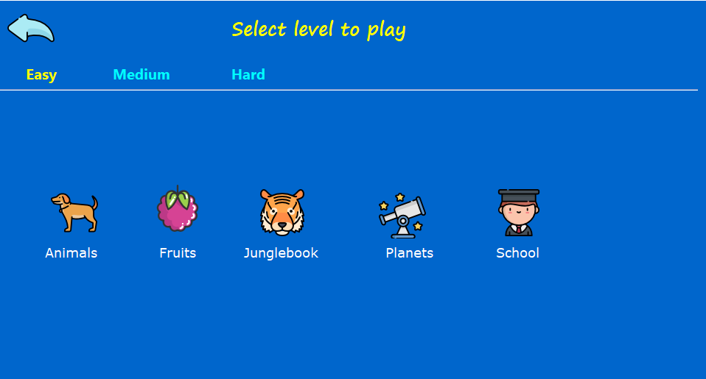
Fig.3 Dash Board
Fig 5. Leaderboard
Fig 4. Level Selection

Slide 8
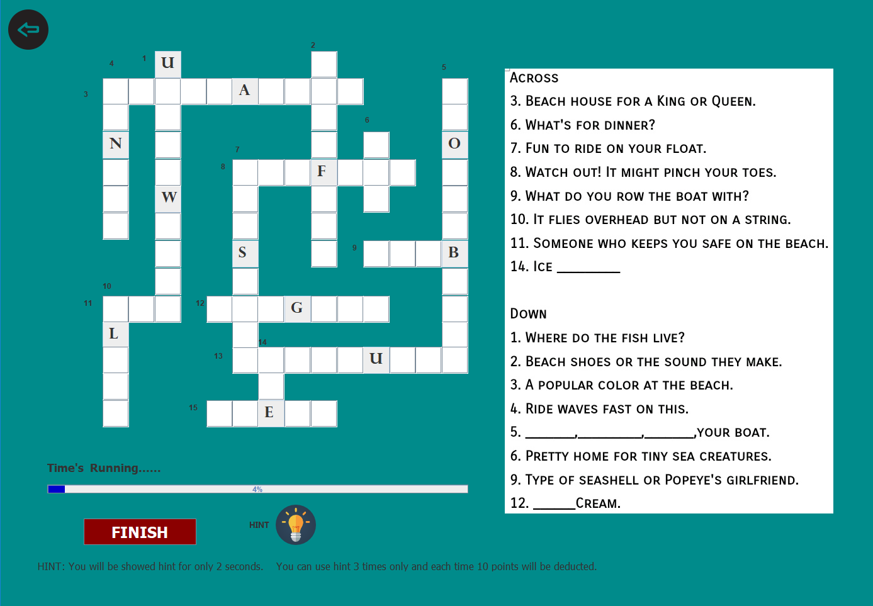
Fig 6. Game Starts!!

Slide 9
Conclusion
This game will help user to improve his/her vocabulary ,command over language and help him/her to release stress.
More beneficial for kids of smaller age.
Kids will learn through entertainment.

Slide 10
References
Websites :
1.www.stackoverflow.com
2.www.youtube.com
3.www.geeksforgeeks.com
Books :
1.The JAVA Complete Reference (Author- Herbert Schildt).

Slide 11
Thank you..
Any Suggestion??

